Slide 1
Which artist should we next invest in to maximize profits?
IST-687 Final Presentation:
Gustavo Gyotoku, Bryan D’Amico, Sachi Singh, Mackenna McCosh
Notes:
Mackenna

Slide 2
Agenda
Slide(s)
Desired Outcome 3
Industry Overview 4
Spotify Data Background 8
Key Findings 9
Next Steps 15
Application demonstration 16
Notes:
Mackenna

Slide 3
Desired Outcome
The purpose of our investigation is to recommend the selection of a new artist who will maximize the likelihood of recording the next hit song on Spotify.
Our selection criteria will be based on the following key findings:
Overall trends among listeners on Spotify
Composition of Popular Music
The common traits of the most popular music
Which genres are likely to be the most profitable?
Notes:
Mackenna

Slide 4
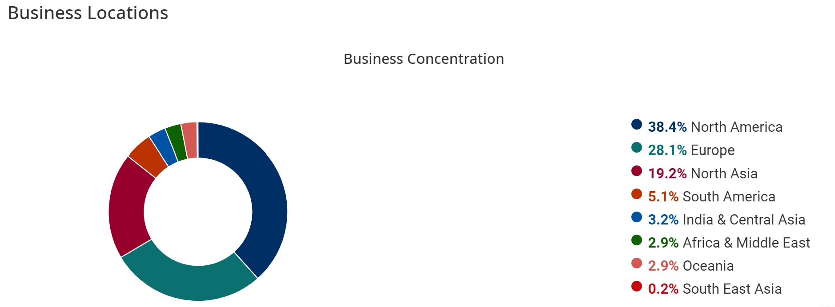
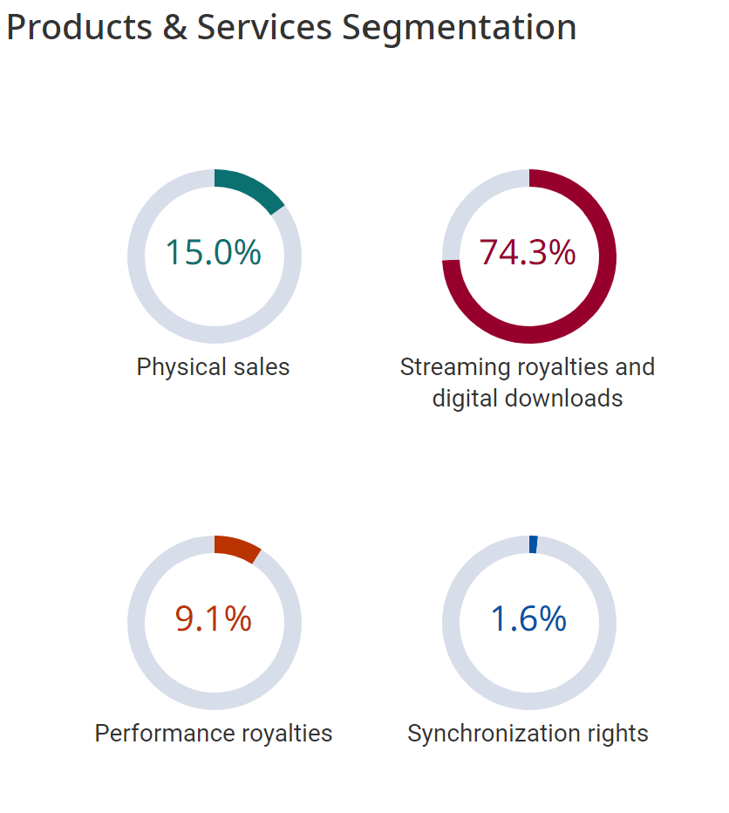
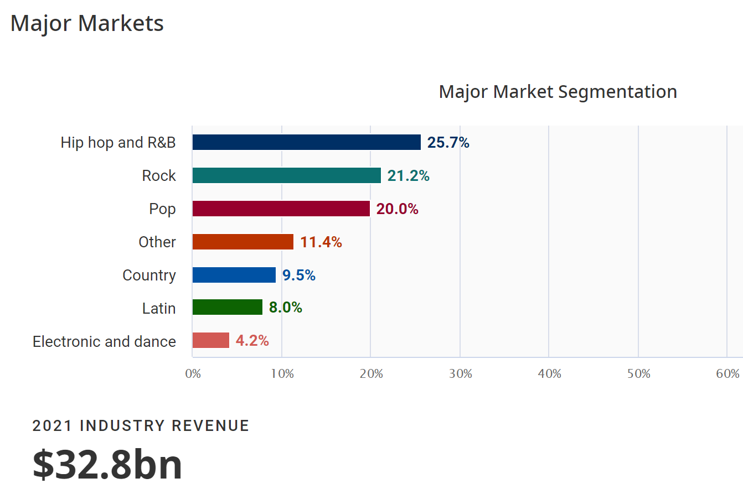
Industry Overview: Global Music Production
9.7% Profit Margin
13,098 Businesses and Growing
IBISWorld Data up to 2021
Notes:
Mackenna

Slide 5
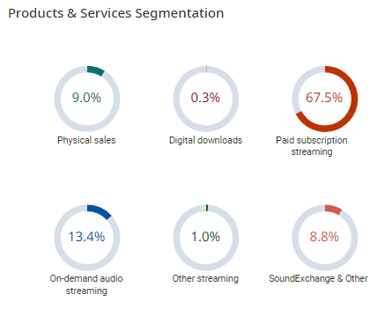
Industry Overview: US Music Production
16.1% Profit Margin
310 Businesses and Growing
IBISWorld Data up to 2021
Notes:
Mackenna

Slide 6
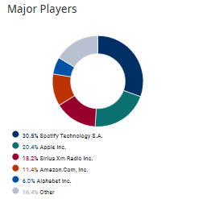
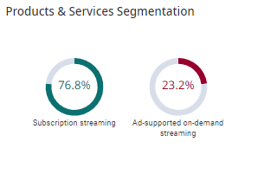
Industry Overview: US Music Streaming
16.1% Profit Margin
310 Businesses and Growing
IBISWorld Data up to 2021
Notes:
Mackenna

Slide 7
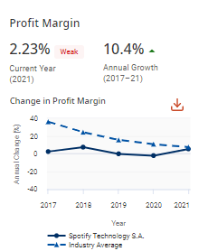
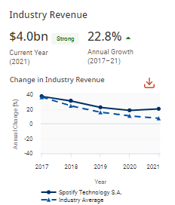
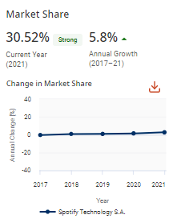

Industry Overview: Spotify
IBISWorld Data up to 2021
Notes:
Mackenna

Slide 8

Spotify Data Background
Source: Kaggle Spotify data set: https://www.kaggle.com/datasets/paradisejoy/top-hits-spotify-from-20002019
Data included:
Popularity
Measurements
Loudness
Amount of vocals
Instrumentation
Length
Key and mood
If it was a live recording
Notes:
Sachi

Slide 9
Key Findings:
Which artist should we next invest in to maximize profits?
Notes:
Sachi

Slide 10
Overall Trends of Popularity on Spotify
Listeners prefer:
Increased tempo
Decreased valence (happiness)
Increased acousticness
Increased danceability
Decreased energy
Decreased duration
Estimation of changes from early 2000s to recent years:
Song duration decreased by 0.5 min
Valence decreased by 0.1
Acousticness increased by 0.0358
Energy decreased by 0.0564
Notes:
Bryan

Slide 11
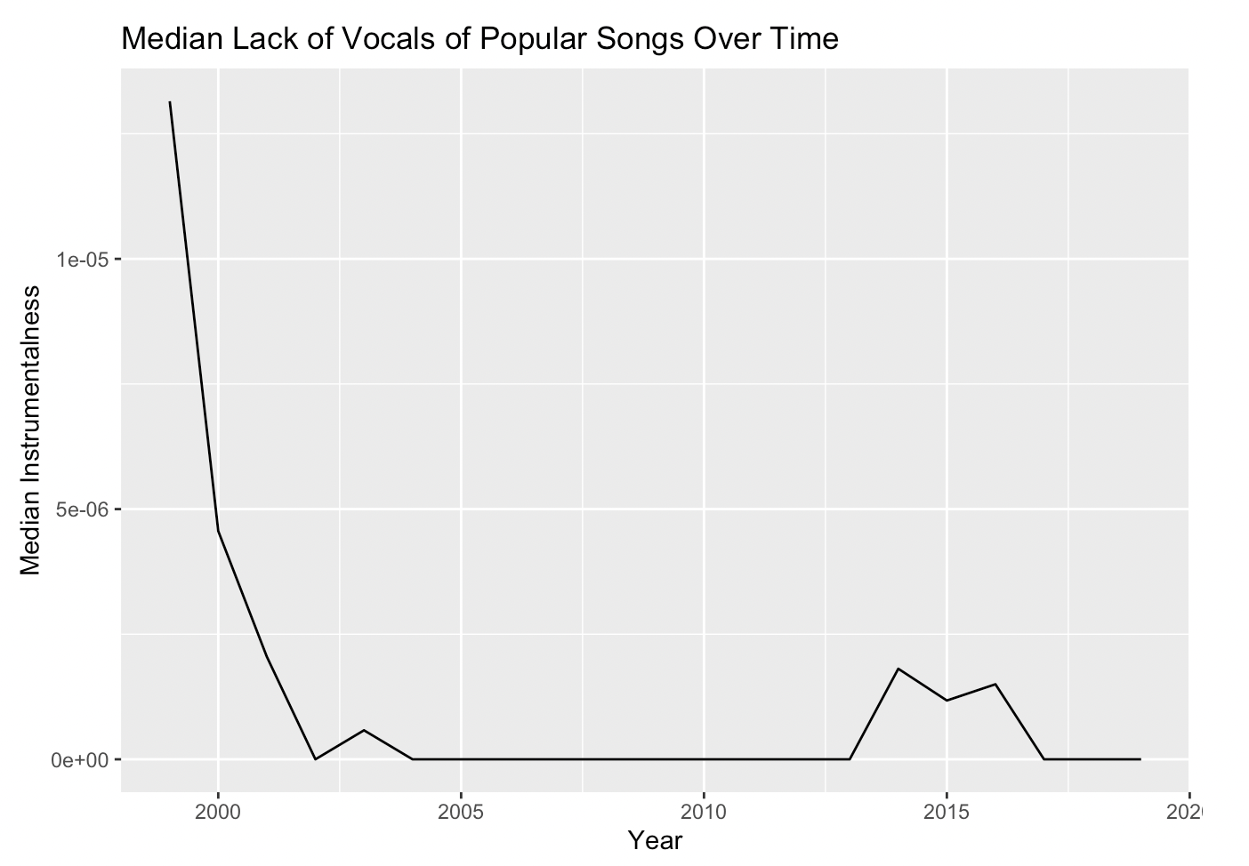
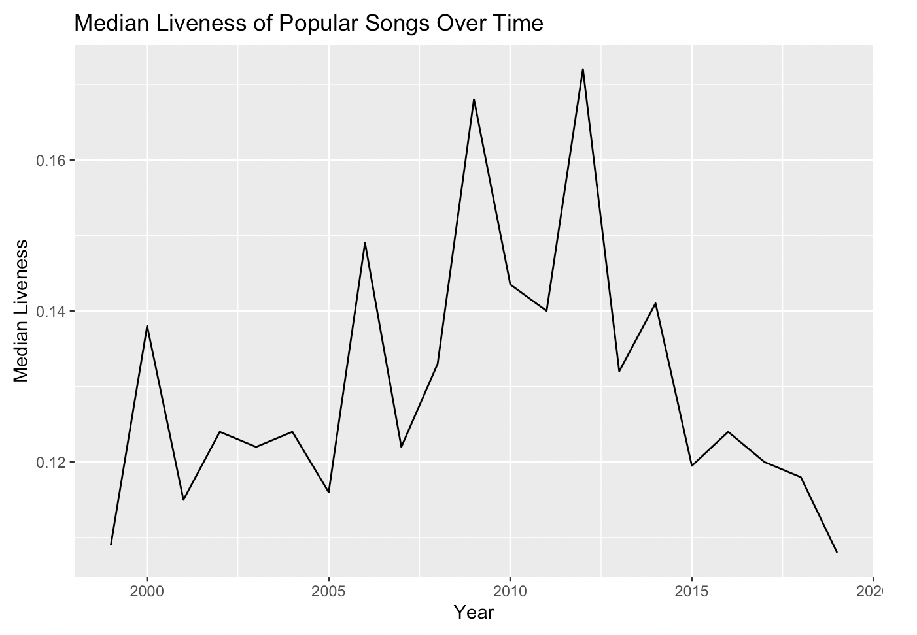
Composition of Popular Music
About 3.5 mins in length
No favorability for instrumental
Low favorability for live songs
Optimal tempo around 120bpm
Slight favorability for negative mood
Low favorability for spoken word
High favorability for danceability
Notes:
Bryan

Slide 12

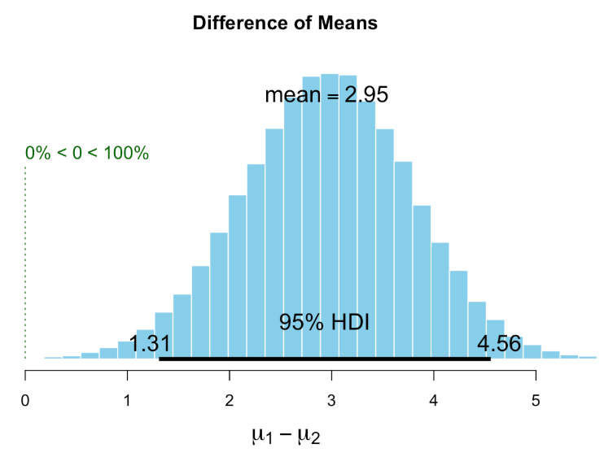
Which Genre is the Most Popular?
Rock has the highest mean and median popularity.
Mean popularity is 2.95 points higher than other genres.
Notes:
Bryan

Slide 13
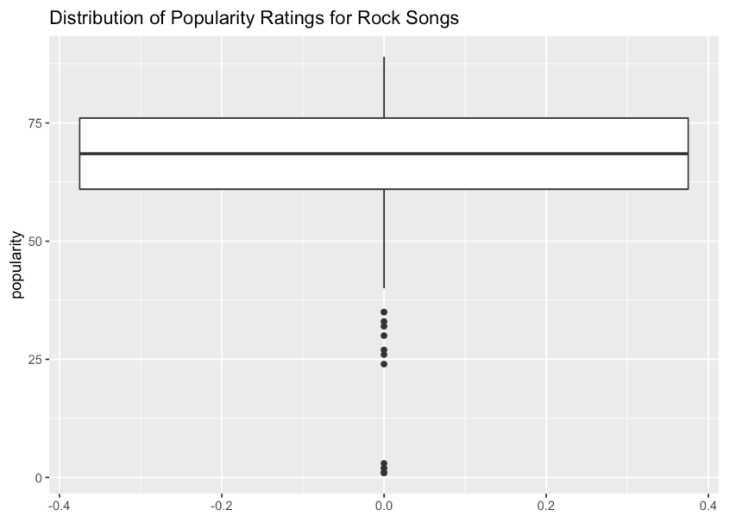
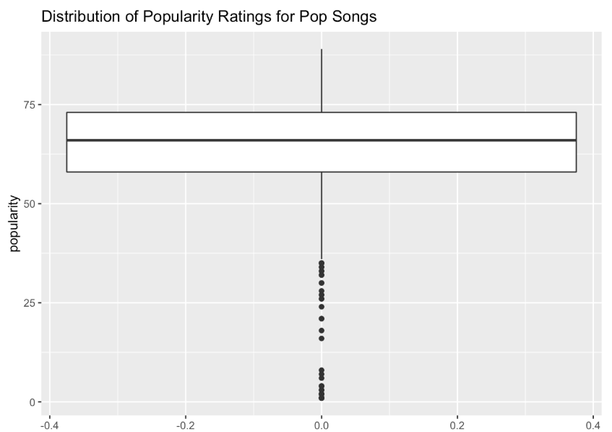
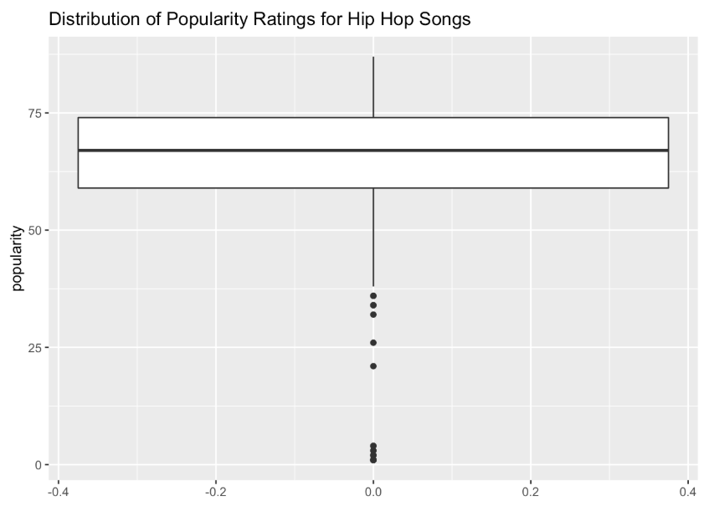
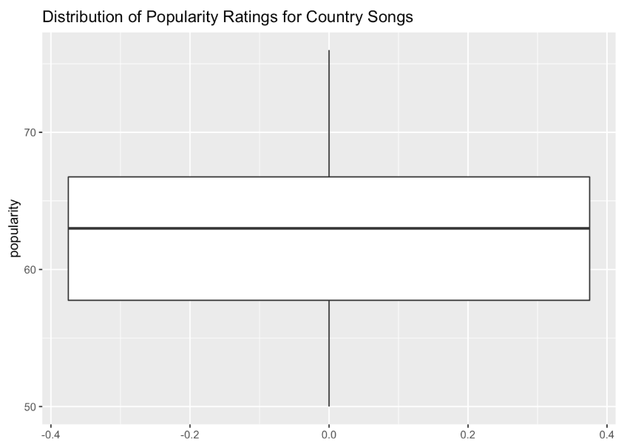
Notes:
Bryan

Slide 14
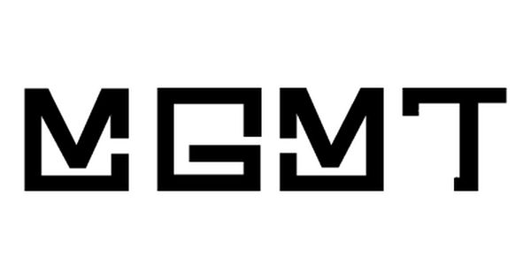
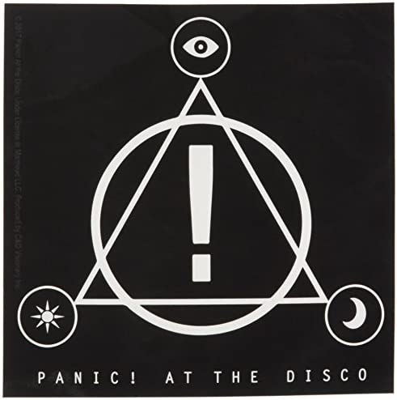
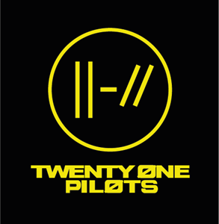


Artist Recommendation:
Rock Artist with:
Lower energy
Feature acoustic guitar
“For fans of” larger artists
Let the algorithm advertise
Song durations of 3-4 mins
Instrumentation and Vocal Balance
Notes:
Bryan

Slide 15
Next Steps:
Create Budget.
Obtain funding.
Build predictive popularity software.
Sign new artists and create new music.
Run music through software.
Produce music with high popularity.
Gain ROI within 1-3 years.
Notes:
Gustavo

Slide 16
Shiny App Demonstration
Notes:
Gustavo

Slide 17
Thanks

